Slide 1
Computer Science
Logical Equivalences
and
Normal Forms
Samuel Lukas

Slide 2
Introduction
Compound propositions that have the same truth values in all possible cases are called logically equivalent.
The propositions P and Q are called logically equivalent if P ↔ Q is a tautology. The notation p ⇔ q denotes that p and q are logically equivalent.
One way to determine whether two propositions are equivalent is to use a truth table or Boolean Algebra.

Slide 3
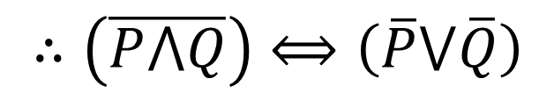
Example 01
Prove !! :
T | T
T | F
F | T
F | F
T
F
F
F
F
T
T
T
F
T
T
T
$$∴\left(\overline{P⋀Q}\right)⟺\left(\overline{P}⋁\overline{Q}\right)$$

Slide 4
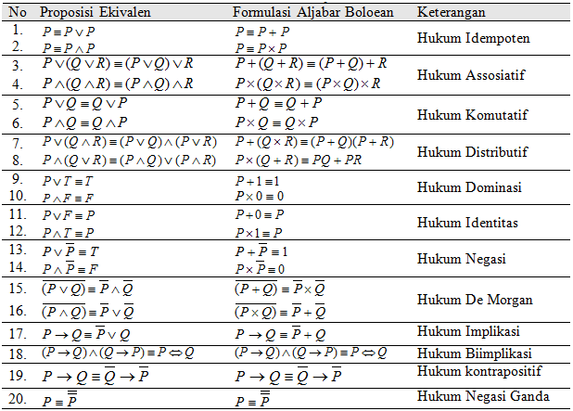
Boolean Algebra

Slide 5
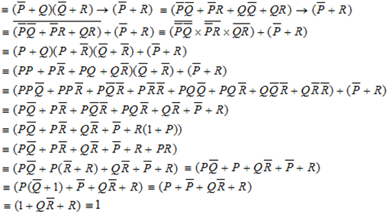

Example 02
Proving :
$$\left(\left(P→Q\right)⋀(Q→R)\right)→(P→R)$$
Is tautology
$∴\left(\left(P→Q\right)⋀(Q→R)\right)→(P→R)$ is Tautology

Slide 6


Normal Forms
Disjuction Normal Forms (DNFs)
$$m=n→FDNF$$
Conjuction Normal Forms (CNFs)
$$m=n→FCNF$$

Slide 7
Example 03
Change the proposition into the two normal forms !!
DNF Form
CNF Form
CNF Form
DNF Form

Slide 8
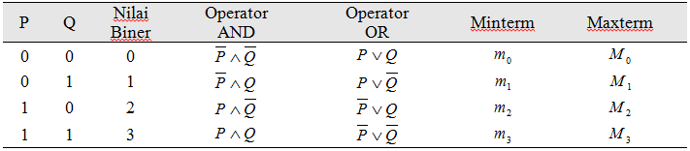
FDNF, FCNF dan Aljabar Boolean
Full DNF
Full CNF

Slide 9
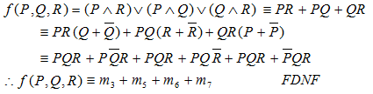
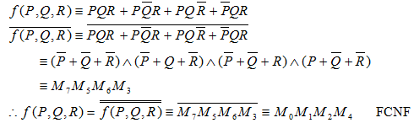
Example 04
To FDNF & FCNF

Slide 10

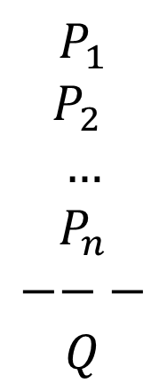
Validity of Argument
$$P_{1}$$
$$P_{2}$$
$$…$$
$$P_{n}$$
$$−−−$$
$$Q$$
Written as :
$\left(P_{1}⋀P_{2}\bigwedge{…⋀P_{n}}\right)⊢$ $Q$
Read as :
If each proposition of P is true then Q is true
Truth Table.
Aljabar Boolean rules
Inference rules
Proving by …..

Slide 11
Example 5
Proving the conclusion of these premises :
If I sing then I am happy
If I dance then I look embarrassing
If I am happy and I look embarrassing then I am smile.
I am nor smiling
Can be concluded that I am not singing or I am not dancing.

